Slide 1

ACROPOLIS INSTITUTE OF TECHNOLOGY
AND RESEARCH
SUBJECT -Evolution of internship
TOPIC – Nmap
SUBMITTED TO:
PROF. Nidhi Nigam
SUBMITTED BY:
Mokshi Diwde

Slide 2

Introduction of Cyber Security
“Cyber Security is the
protection of internet
connected system
including hardware,
software and program
or data from cyber attacks”

Slide 3
Need of Cyber Security
Cyber Security
To protect private data
To protect intellectual data
To protect banking and financial data
National Security
Global Security
Protect Sensitive data
Cyber
Security
Computer
System
Network
Program or
data
System Security
Network Security
Problem or data Security

Slide 4
Types of Cyber threats
Malware (virus)
SQL injection
Phishing
Man in the middle attack
Protect yourself to Cyber attacks
Update software and os
Use anti virus
Use string password
Avoid using unsecure wifi networks in public places

Slide 5
Types of Heakers
Black hat hackers
White hat hackers
Gray hat hackers
Red hat hackers
Network scanning
“network scanning” is the process allowing you to determine all active devices on your network. Active scanning is when the tool sends a ping to each device on the network and awaits a response. The scanner then looks at the responses it gets to see if there are inconsistencies or vulnerabilities.

Slide 6
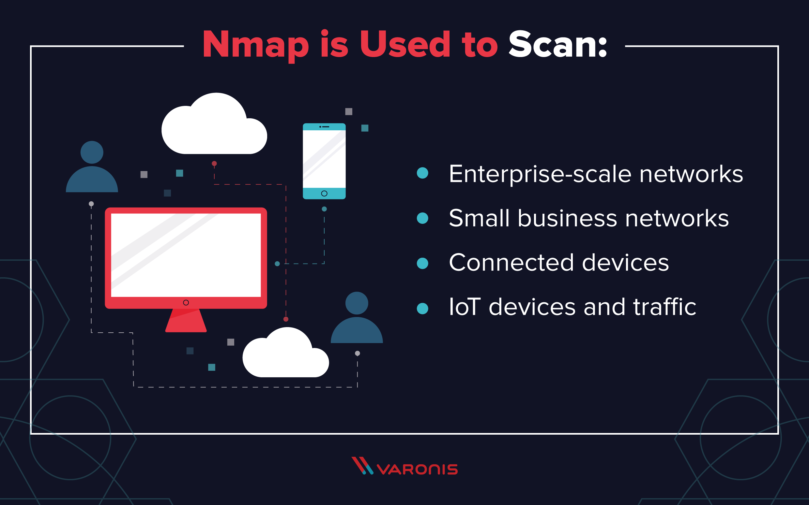
Nmap (Network Mapping tool)
Nmap is a network mapper that has emerged as one of the most popular, free network discovery tools on the market. Nmap is now one of the core tools used by network administrators to map their networks.

Slide 7
Why use Nmap?
Nmap can find information about the operating system running on devices. It can provide detailed information like OS versions, making it easier to plan additional approaches during penetration testing.
Nmap has a graphical user interface called Zenmap. It helps you develop visual mappings of a network for better usability and reporting.

Slide 8
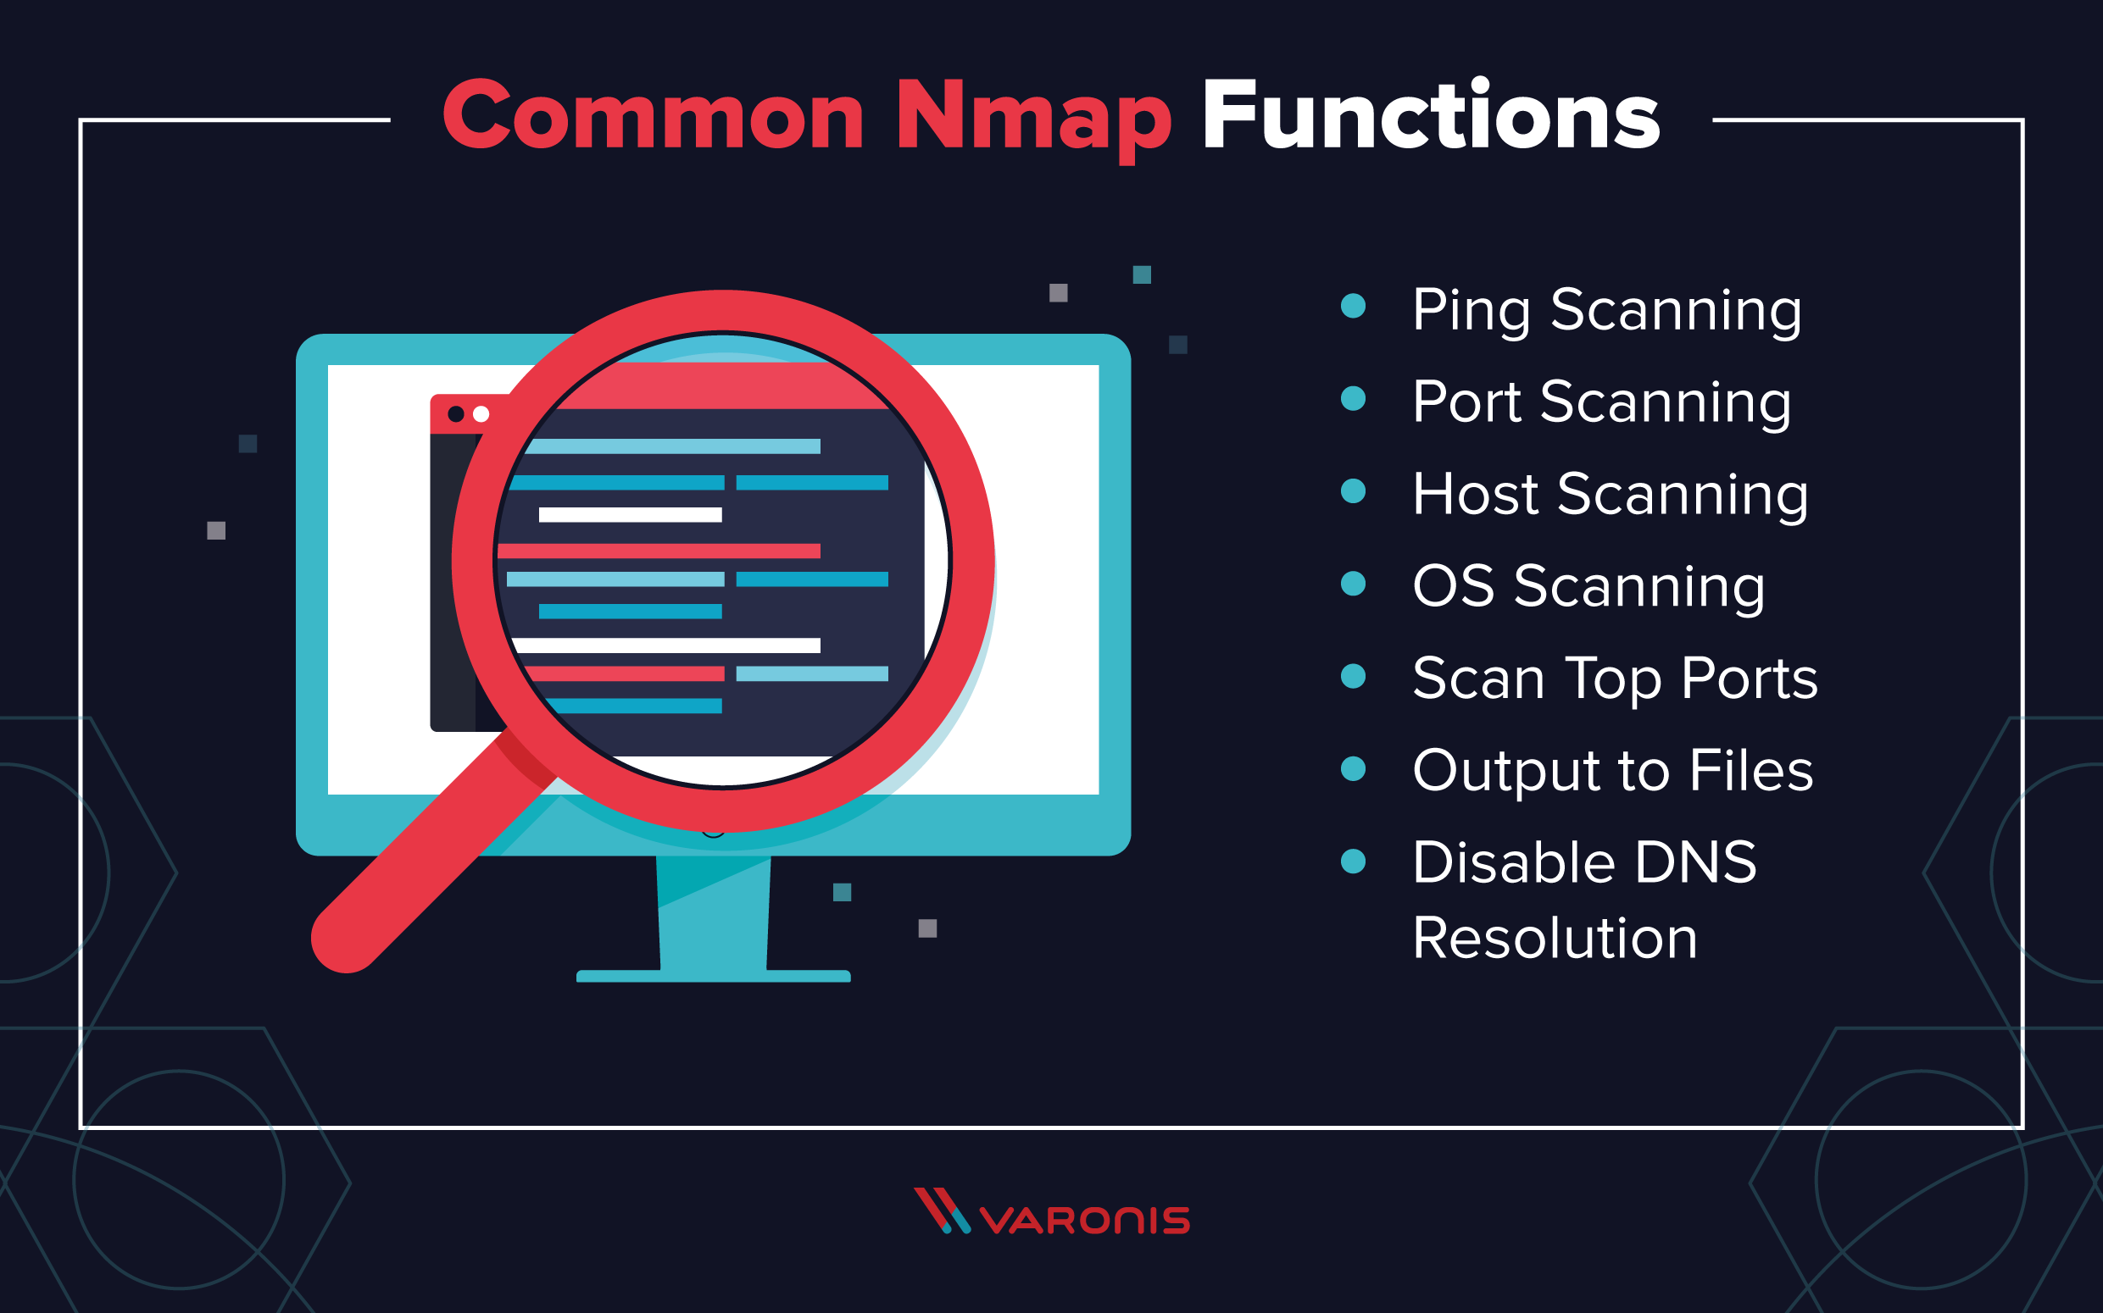
Nmap Commands
Most of the common functions of Nmap can be executed using a single command, and the program also uses a number of ‘shortcut’ commands that can be used to automate common tasks.

Slide 9
Thank you

